Slide 1
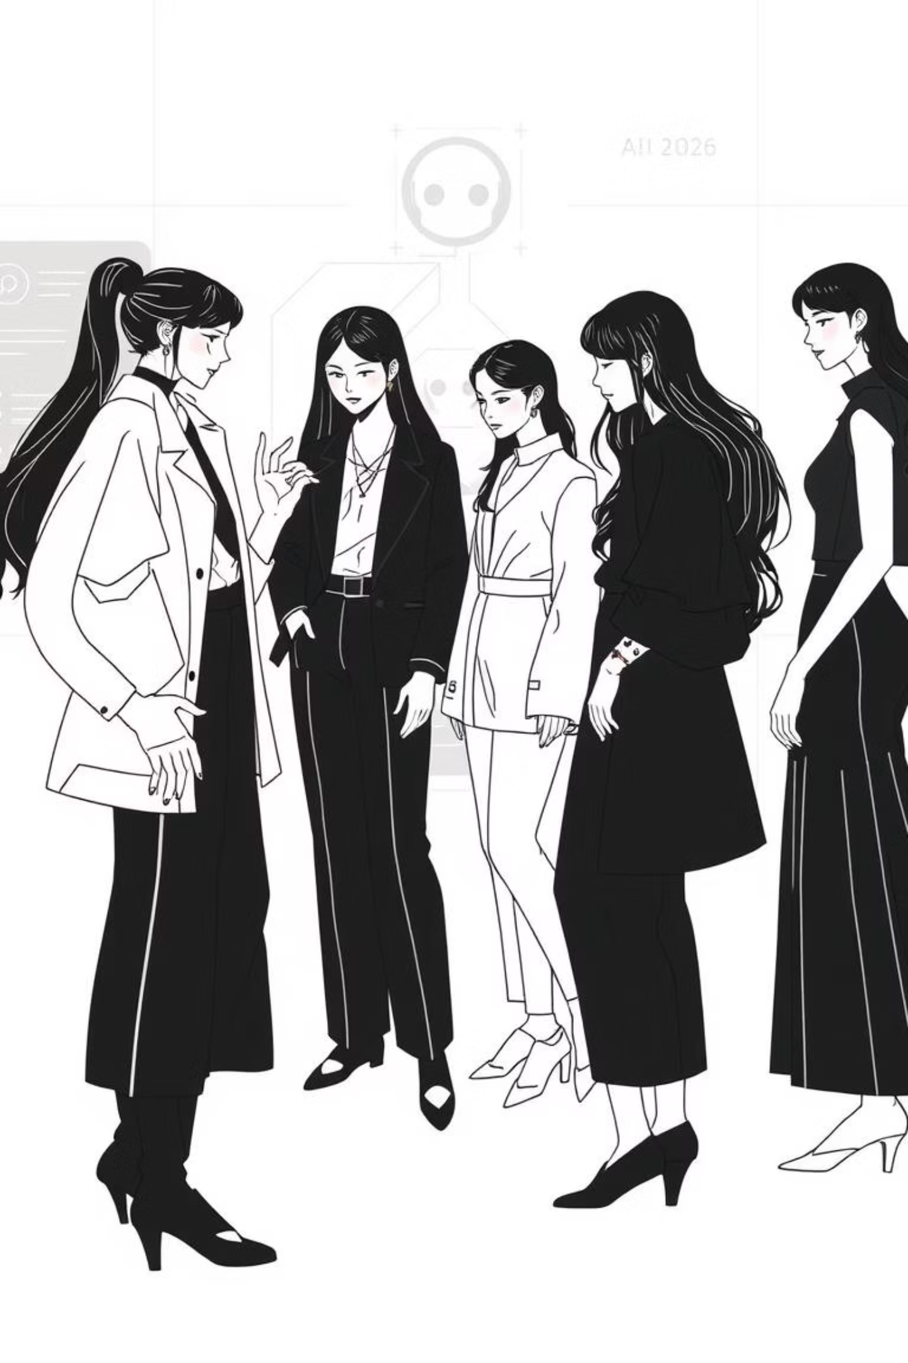


TrendyWare
Name: Shah Het Viralkumar
Enrollment Number:2300271210157
Roll Number:128

Slide 2



Motive of the Project
Personalization
Awareness
Management
Empowering users with AI-driven fashion recommendations tailored to their age, gender, and skin tone, creating a highly personalized shopping experience that enhances confidence and satisfaction.
Promoting fashion culture by providing a centralized platform for discovering fashion festivals across India, connecting users with ongoing events and style movements.
Streamlining product and event management through a dedicated admin interface, enabling efficient handling of shop items and fashion fest listings for a responsive and dynamic storefront.

Slide 3
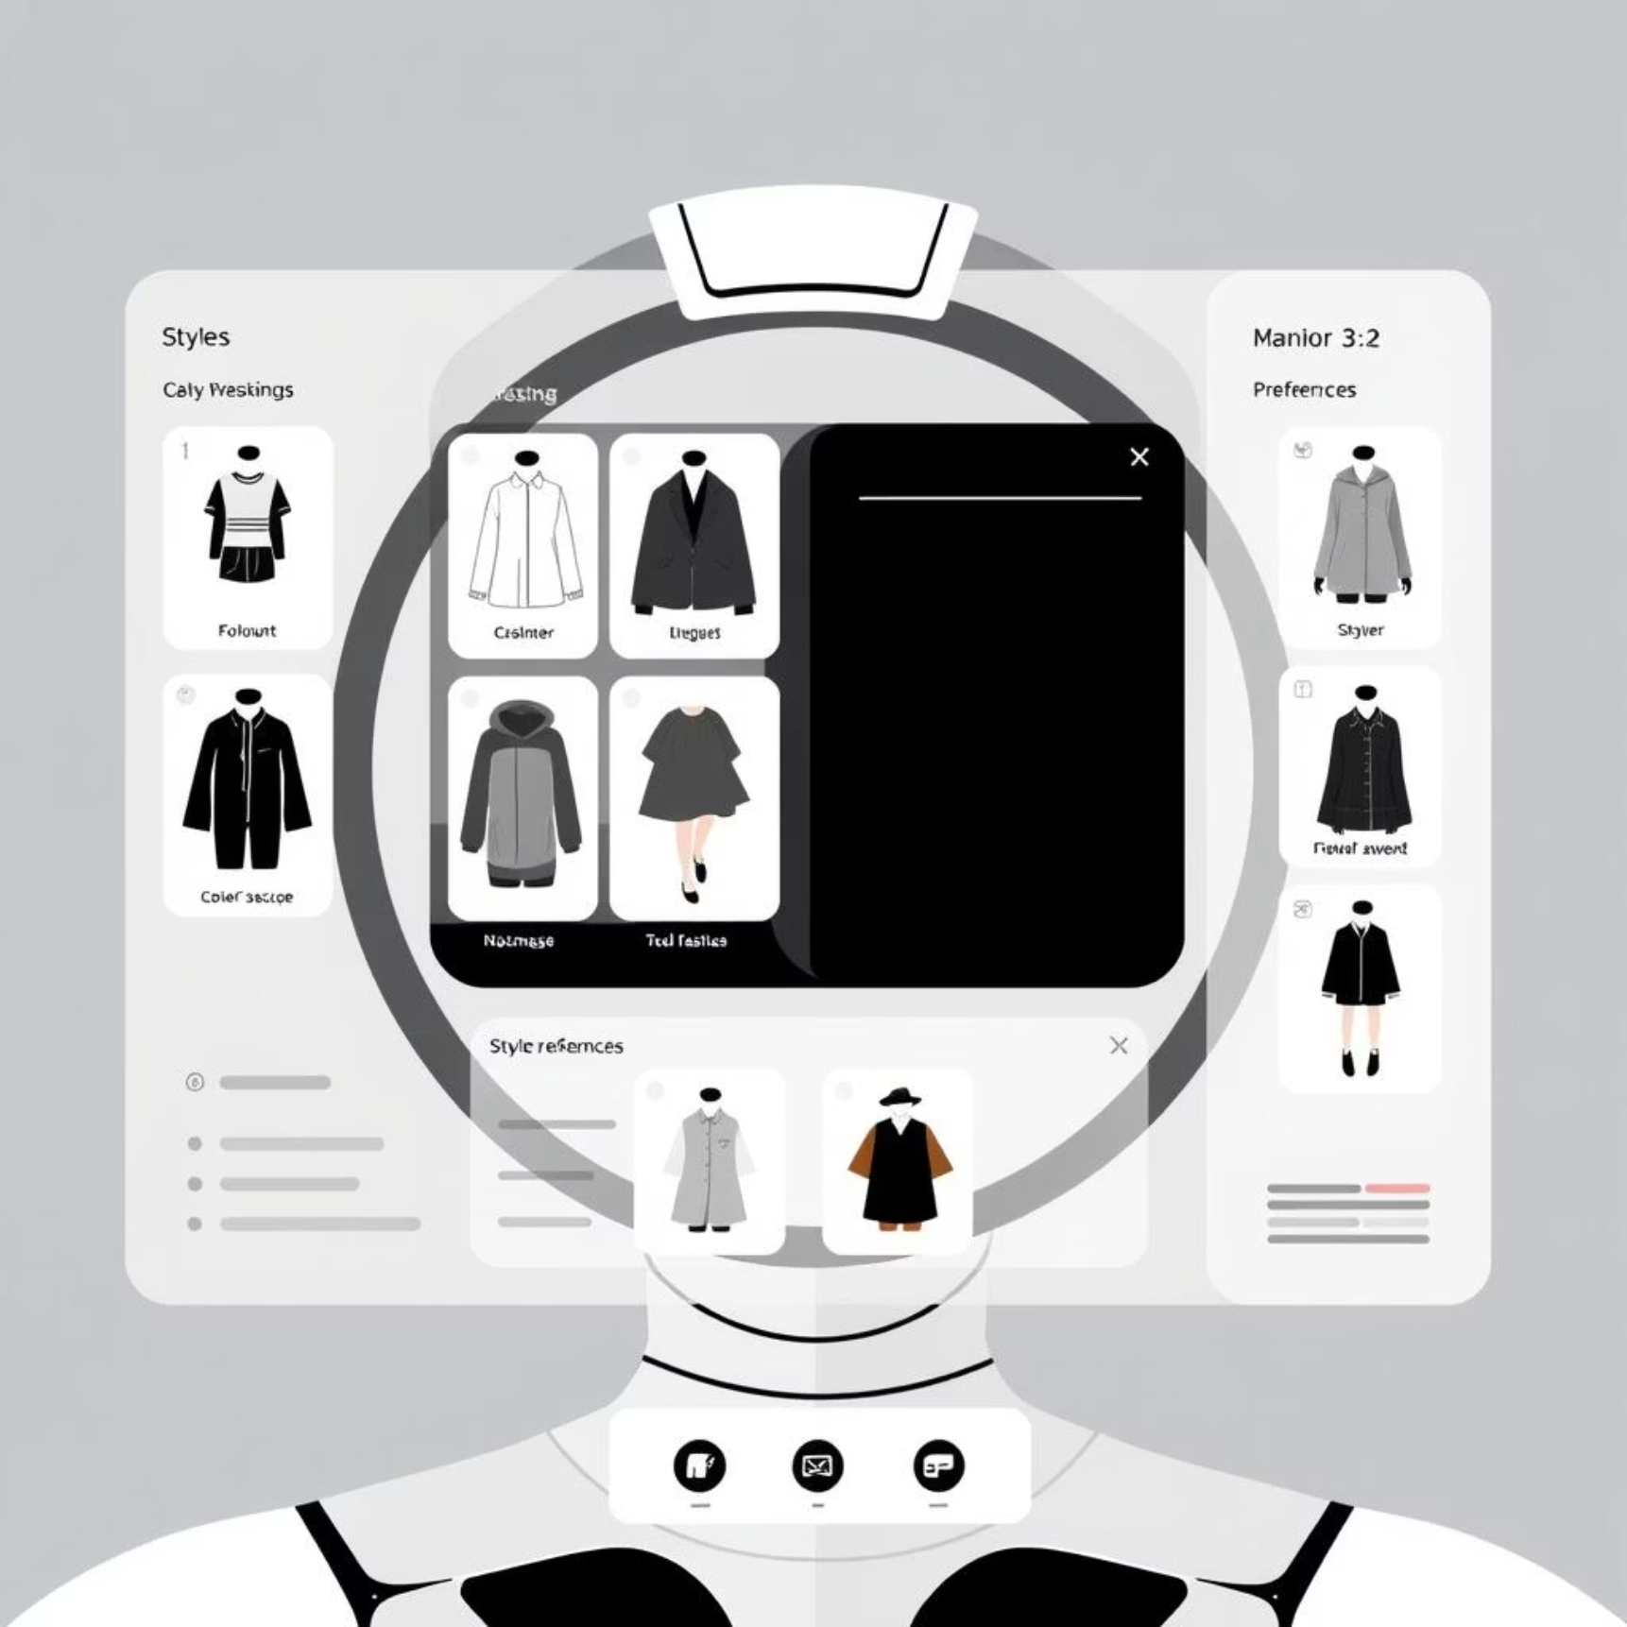
Functionality of the Project
1
AI-Powered Style Recommendations
Users can upload their photo to receive intelligent fashion suggestions based on their facial features, age, gender, and skin tone using a custom-trained model with Fashion-CLIP and the Kaggle fashion dataset.
2
Interactive Fashion Fest Listings
A dedicated page showcases ongoing and upcoming fashion festivals across India, allowing users to explore events, stay updated on trends, and engage with the fashion community.
3
Smart Online Shopping Interface
The Shop page displays curated fashion items fetched from the database, including those recommended by the AI, allowing users to browse, view details, and make purchases seamlessly.
4
Admin Control for Products and Events
An admin-exclusive interface allows easy management of shop inventory and fashion fest data, supporting create, read, update, and delete (CRUD) operations with direct database connectivity.

Slide 4
Technologies used in the Project
React-Based Frontend Architecture
Dual Backend Infrastructure (Node + Django)
The entire user interface is built using React, providing a dynamic, component-driven experience with smooth routing and real-time interactivity across pages like Home, Shop, AI Stylist, and Admin.
A Node.js + Express backend handles authentication, routes, and database operations, while a separate Django server powers the AI Stylist feature using Fashion-CLIP and deep learning models.
MongoDB for Flexible Data Storage
ML Model Integration with Fashion-CLIP Model
Product listings, user details, and fashion fest data are stored in MongoDB, a NoSQL database well-suited for scalable, schema-less data handling, and integrated directly into the Node backend.
The AI Stylist leverages Fashion-CLIP, a vision-language model, trained on the Kaggle fashion product images dataset to understand style semantics and recommend context-aware clothing items.

Slide 5
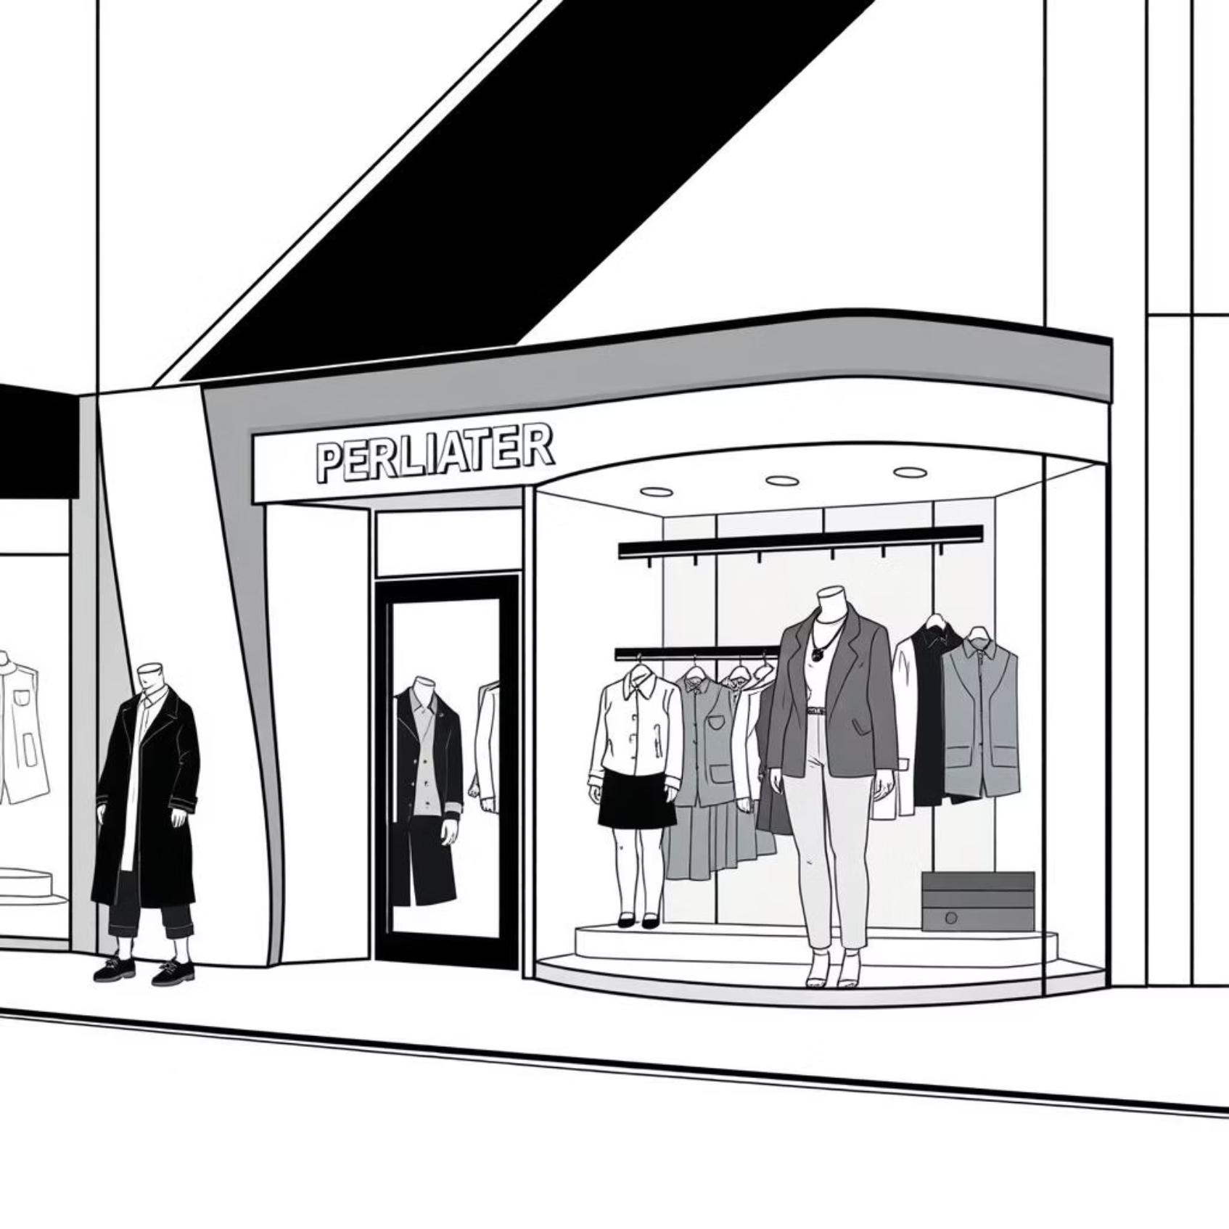
Future Scopes of the Project
Virtual Try-On System: Implement AR-based virtual try-on features allowing users to see how clothes would look on them in real-time using their webcam or uploaded image, enhancing user confidence before purchase.
Voice and Chatbot Styling Assistant: Integrate a voice-enabled or chatbot-based personal stylist that can answer queries, suggest outfits, and guide users through shopping based on their style preferences and body type.
Real-time Fest Booking and Ticketing: Enable users to register, book tickets, or reserve stalls for fashion festivals directly through the platform, turning the fest page into an interactive event management tool.
Integration with Influencer and Trend Feeds: Add a dedicated section that showcases trending outfits, influencer-curated collections, and social media fashion feeds, helping users stay updated with the latest styles and shop influencer-inspired looks directly.

Slide 6

Thank You

